Slide 1
COVID-19 : Case Investigation
Presented by
S.Kalaimagal
T.Varshasri
M.Mugil
M.Manibharathi

Slide 2
Contents of this template
Here’s what you’ll find in this Slidesgo template:
A slide structure based on a clinical case presentation, which you can easily adapt to your needs. For more info on how to edit the template, please visit Slidesgo School or read our FAQs.
An assortment of graphic resources that are suitable for use in the presentation can be found in the alternative resources slide.
A thanks slide, which you must keep so that proper credits for our design are given.
A resources slide, where you’ll find links to all the elements used in the template.
Instructions for use.
Final slides with:
The fonts and colors used in the template.
A selection of illustrations. You can also customize and animate them as you wish with the online editor. Visit Storyset to find more.
More infographic resources, whose size and color can be edited.
Sets of customizable icons of the following themes: general, business, avatar, creative process, education, help & support, medical, nature, performing arts, SEO & marketing, and teamwork.
You can delete this slide when you’re done editing the presentation.

Slide 3
Table of contents
01
02
03
The patient
Discussion
Diagnosis
04
05
Treatment
Patient monitoring
You can describe the topic of the section here
You can describe the topic of the section here
You can describe the topic of the section here
You can describe the topic of the section here
You can describe the topic of the section here

Slide 4
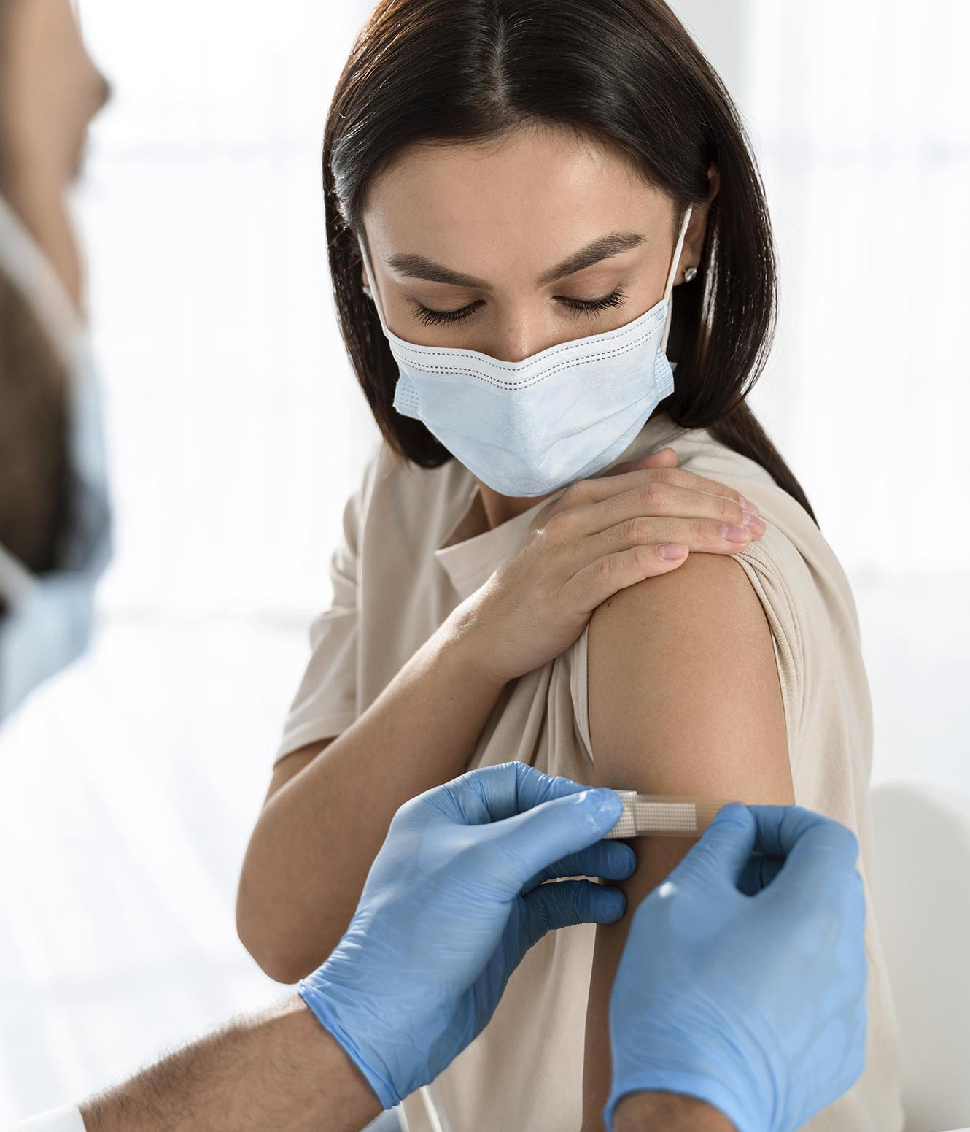
Introduction
You can give a description of the topic you want to talk about here. For example, if you want to talk about Mercury, you can say that it’s the smallest planet of them all

Slide 5
Identifying information
Mercury
Venus
Jupiter
Mars
It’s the closest planet to the Sun and the smallest one
Venus is the second planet from the Sun. It’s really hot there
Jupiter is a gas giant and the biggest planet of them all
Despite being red, Mars is actually a very cold place

Slide 6
01
The patient
You can enter a subtitle here if you need it

Slide 7
—Someone Famous
“This is a quote, words full of wisdom that someone important said and can make the reader get inspired.”

Slide 8
Review of systems
Mercury
Venus
Mars
It’s the closest planet to the Sun and the smallest one in the Solar System
Venus has a beautiful name and is the second planet from the Sun
Despite being red, Mars is actually a cold place. It’s full of iron oxide dust

Slide 9
Physical examination
Saturn
Jupiter
Saturn is a gas giant with rings. It’s composed of hydrogen and helium
It’s a gas giant and the biggest planet in the entire Solar System
Neptune
Mercury
It's the fourth-largest object by diameter in the Solar System
It’s the closest planet to the Sun and also the smallest one

Slide 10
123,456.789
Big numbers catch your audience’s attention

Slide 11
Map of cases
Alpha
Delta
Saturn is a gas giant with rings
Earth is where we all live on
Beta
Epsilon
Mercury is a very small planet
Venus has a beautiful name
Gamma
Zeta
Jupiter is a very big planet
Mars is actually a cold place

Slide 12
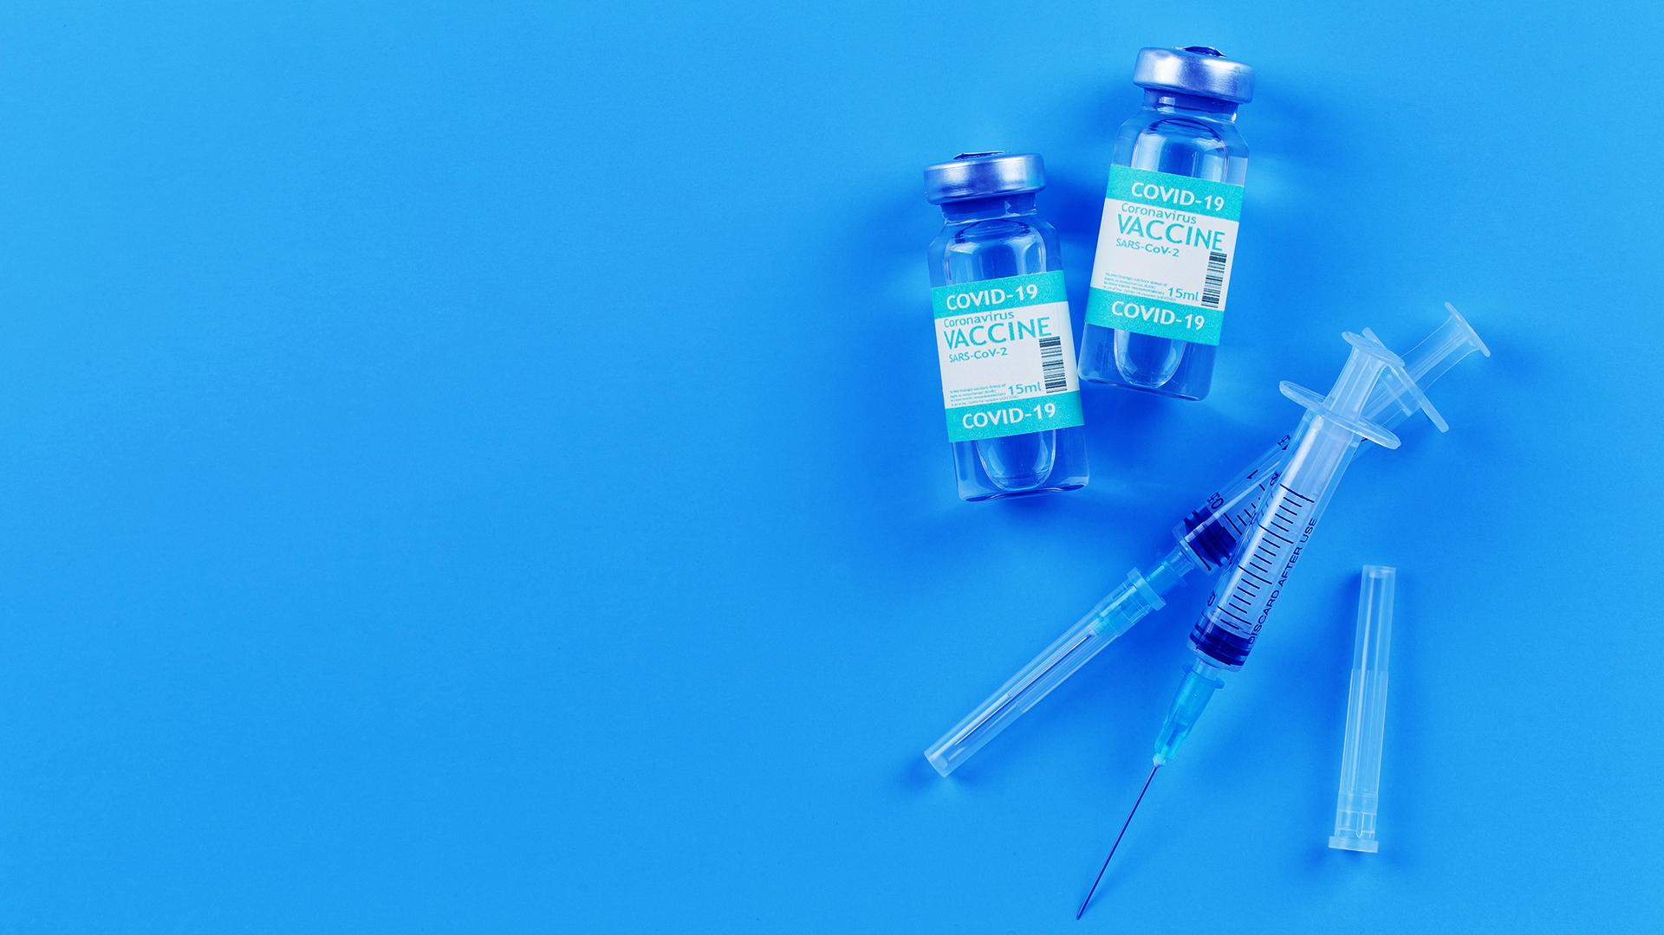
A picture is worth a thousand words

Slide 13
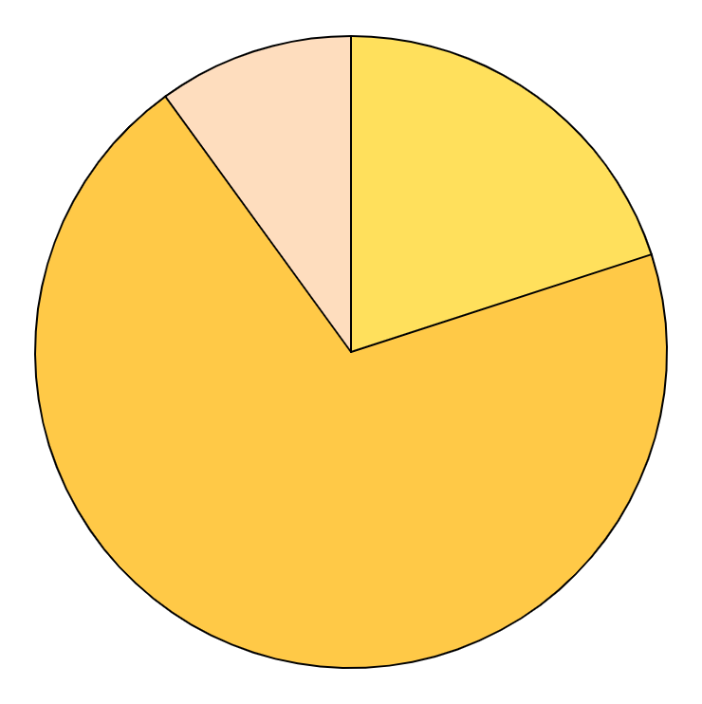
Vaccination graph
Dose 2
Dose 1
Jupiter is a very big planet
Mercury is a very small planet
Non vaccinated
Jupiter is the biggest planet in the Solar System
Follow the link in the graph to modify its data and then paste the new one here. For more info, click here

Slide 14
02
Discussion
You can enter a subtitle here if you need it

Slide 15
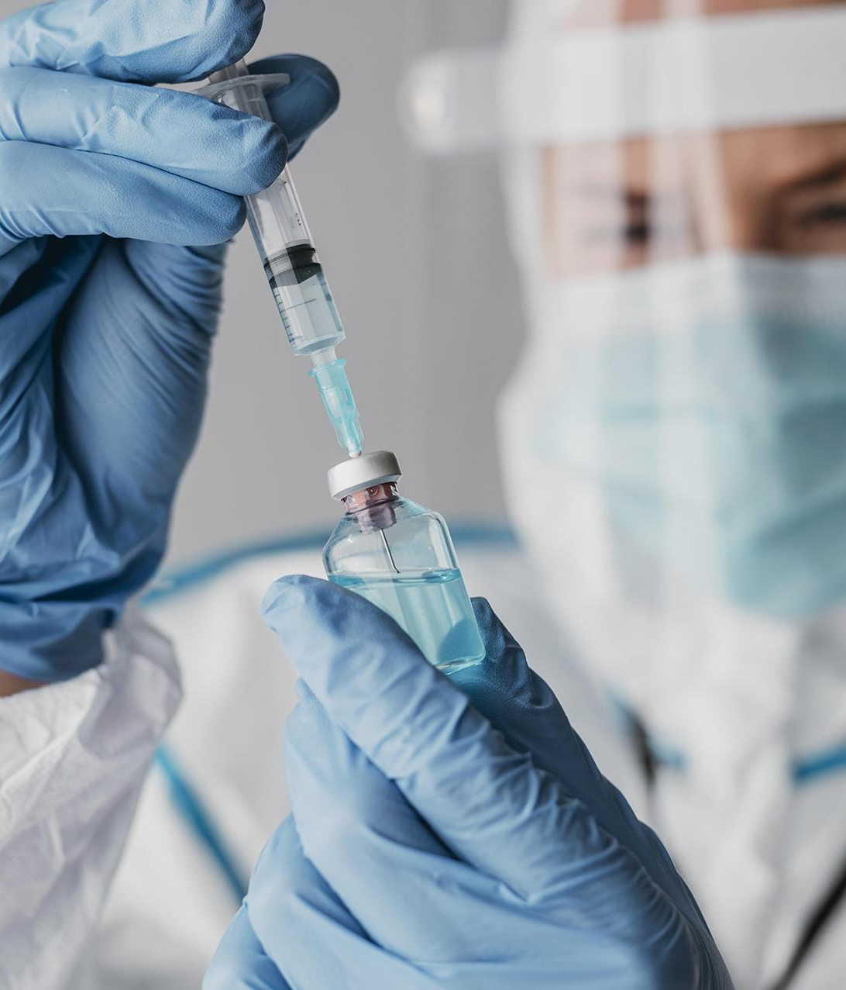
Discussion points
Do you know what helps you make your point clear?
Lists like this one:
They’re simple
You can organize your ideas clearly
You’ll never forget to buy milk!
And the most important thing: the audience won’t miss the point of your presentation

Slide 16
Post-prevention
Social distance
Earth is the third planet from the Sun and the only one that harbors life
Wear a mask
Jupiter is a gas giant and the biggest planet in the entire Solar System
Daily exercise
Mercury is the closest planet to the Sun and the smallest one

Slide 17
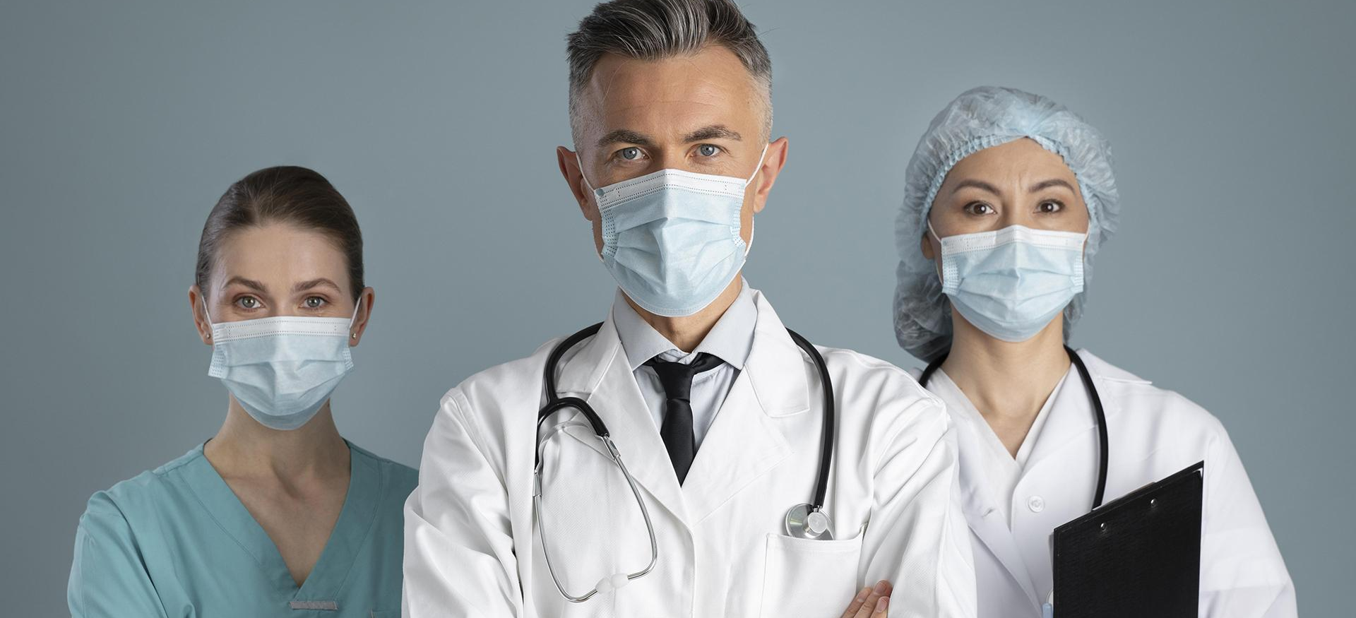
Our team
Susan Bones
Timmy Jimmy
Emma James
You can speak a bit about this person here
You can speak a bit about this person here
You can speak a bit about this person here

Slide 18
Comparison
Symptoms | Dose 1 | Dose 2 | No vaccine
Mercury is the closest planet to the Sun
Venus is the second planet from the Sun
Mars is actually a very cold place
Neptune is far away from Earth

Slide 19
Discussion
“Venus is the second planet from the Sun”
“Jupiter is the biggest planet in the Solar System”
“Despite being red, Mars is a very cold place”
Dr. Smith
Dr. James
Dr. Doe

Slide 20
9h 55m 23s
333,000.000
386,000 km
Is Jupiter's rotation period
Earths is the Sun’s mass
Is the distance between Earth and the Moon

Slide 21
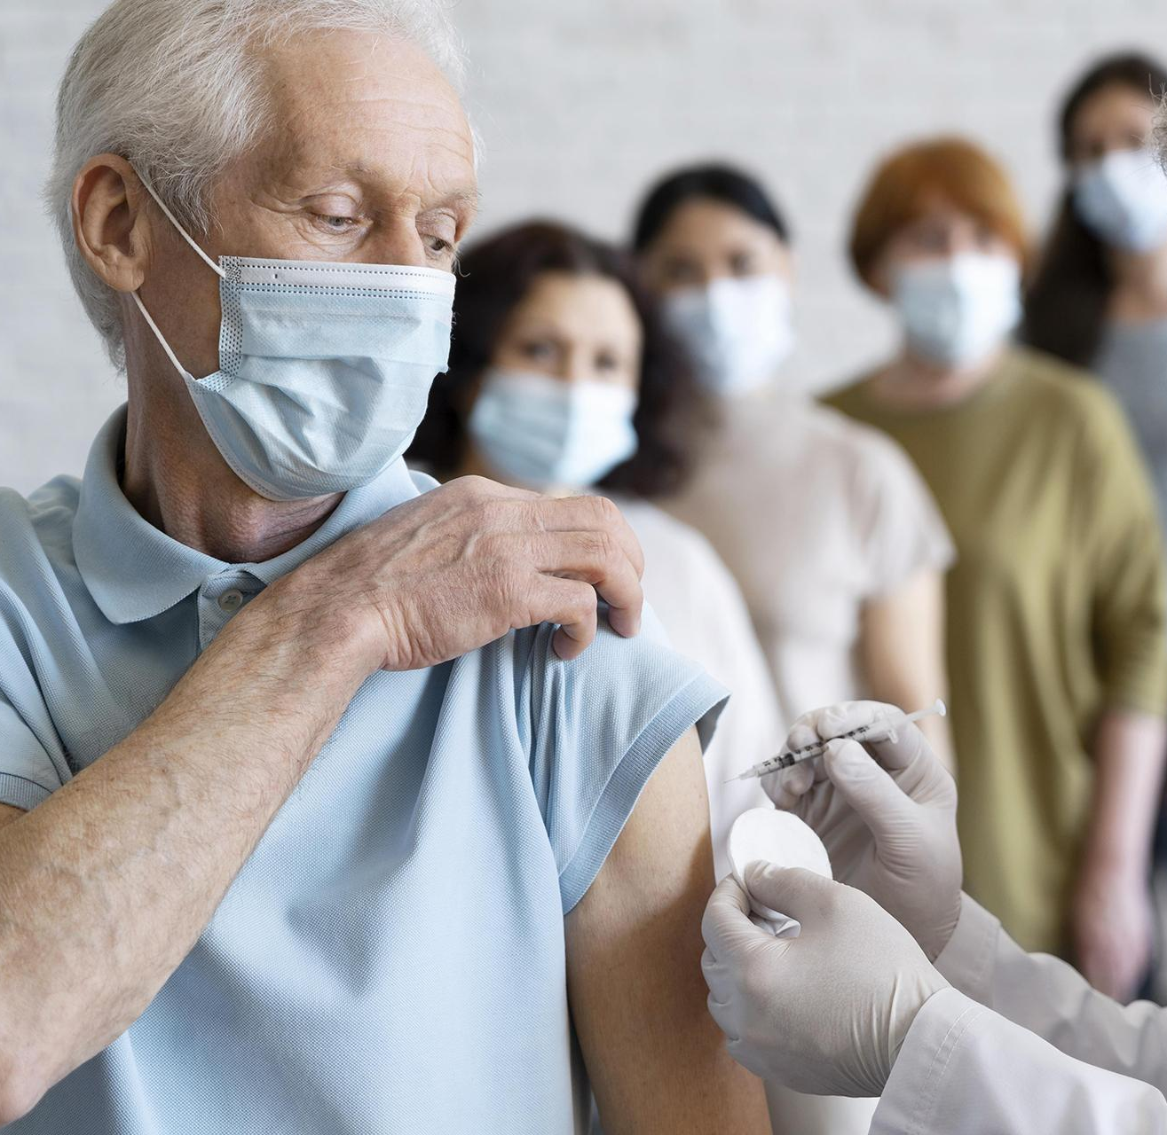
Our treatment
Venus
Venus is the second planet from the Sun
Mars
Despite being red, Mars is a cold place
Saturn
It’s composed of hydrogen and helium

Slide 22
Diagnosis
Mars
Mercury
Neptune
Mars is actually a very cold place
It’s the closest planet to the Sun
It’s the farthest planet from the Sun
Venus
Saturn
Jupiter
Venus is the second planet from the Sun
It’s composed of hydrogen and helium
Jupiter is the biggest planet of them all

Slide 23
Patient monitoring
Week 1
Week 3
Despite being red, Mars is a cold place
Jupiter is the biggest planet of them all
Week 2
Week 4
Saturn is a gas giant and has several rings
Venus is the second planet from the Sun

Slide 24
Awesome words

Slide 25
Contraindications & indications
You can describe the reason to stop the treatment here
You can describe the reason to stop the treatment here
You can describe the reason to stop the treatment here
You can describe the reason to stop the treatment here
You can describe the reason to start the treatment here
You can describe the reason to start the treatment here
You can describe the reason to start the treatment here
You can describe the reason to start the treatment here

Slide 26
Case timeline
Day 1
Day 2
Day 3
Mars
Venus
Mercury
Despite being red, It’s a cold place
Venus is the second planet from the Sun
It’s the smallest planet of them all

Slide 27
Medical conclusion
Mercury is the closest planet to the Sun and the smallest one in the Solar System. The planet’s name has nothing to do with the liquid metal since it was named after the Roman messenger god, Mercury

Slide 28
References
Author (Year). Title of the publication. Publisher
Author (Year). Title of the publication. Publisher
Author (Year). Title of the publication. Publisher
Author (Year). Title of the publication. Publisher
Online publication (Website). Title of the publication
Online publication (Website). Title of the publication
Online publication (Website). Title of the publication
Online publication (Website). Title of the publication

Slide 29
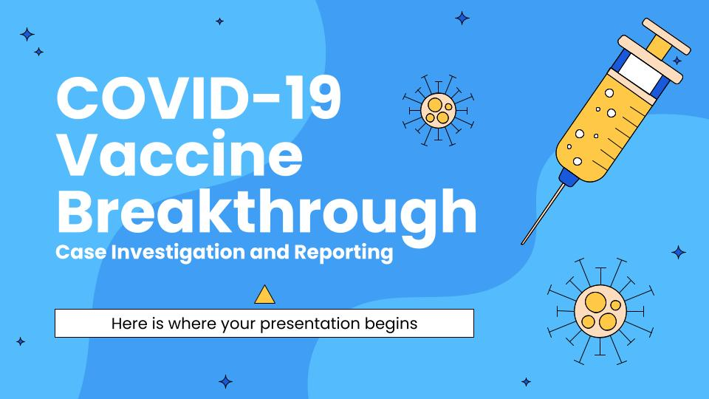
Our website
You can replace the image on the screen with your own work. Just right-click on it and select “Replace image”

Slide 30
Thankyou!

